Slide 1
Intraday Liquidity Risk management Gap Analysis & Proposal
Market Risk Management Department
February 24 2017

Slide 2
What Is Intraday Liquidity
Intraday Liquidity: Funds which can be accessed during the business day, usually to enable banks to make payments in real time
Intraday Liquidity Risk: The risk that a bank fails to manage its intraday liquidity effectively, which could leave it unable to meet a payment obligation at the time expected, thereby affecting its own liquidity position and that of other parties.
Intraday Liquidity Sources
Intraday Liquidity Usage
Own sources
Reserve balances at the central bank;
Collateral pledged with the central bank or with ancillary systems that can be freely converted into intraday liquidity;
Unencumbered assets on a bank’s balance sheet that can be freely converted into intraday liquidity;
Secured and unsecured, committed and uncommitted credit lines available intraday;
Balances with other banks that can be used for intraday settlement.
Other sources
Payments received from other LVPS participants;
Payments received from ancillary systems;
Payments received through correspondent banking services.
Daylight overdraft capacity (FRB Net debit cap)
Payments made to other LVPS participants;
Payments made to ancillary systems;
Payments made through correspondent banking services;
Secured and unsecured, committed and uncommitted credit lines offered intraday;
Contingent payments relating to a payment and settlement system’s failure (e.g. as an emergency liquidity provider).

Slide 3

Why Is Intraday Liquidity Important
Many banks with clearing business still do not have sound intraday liquidity process. It is critical to develop a system of how to manage the bank itself on an intraday basis.
Industry Implications
Implications
Visibility of intraday liquidity usage
Data accuracy validation
Forecasting stressed intraday
Tools should be available to allow the drill down real time to identify the drivers of intraday
Regulations: Regulation YY & BCBS
Reason for Lehman’s failure: Although Lehman had a good looking liquidity buffer, it didn’t have a sound intraday liquidity risk management.
The last financial crisis demonstrated the consequences when the process of managing intraday liquidity goes wrong and banks fail to obtain the funding they need to meet their obligations.
The increase in payments settled in real-time through Large Value Payments Systems (LVPS), interdependence between payments and settlement systems, concentration of financial flows and changes in payments throughput have increased intraday liquidity needs and related risks.

Slide 4
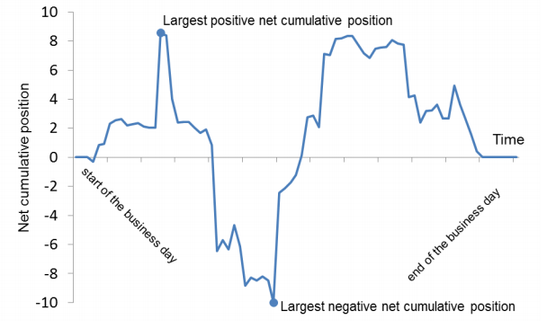
How?--Daily Maximum Liquidity Requirement
This tool will enable supervisors to monitor a bank’s intraday liquidity usage in normal conditions. It will require banks to monitor the net balance of all payments made and received during the day over their settlement account, either with the central bank or over their account held with a correspondent bank
When a bank runs a positive net cumulative position, it has surplus liquidity available to meet its intraday liquidity obligations. This position may arise because the bank is relying on payments received from other LVPS participants to fund its outgoing payments.
When a bank runs a negative net position at some point intraday, it will need access to intraday liquidity to fund this balance.
The minimum amount of intraday liquidity that a bank would need to have available on any given day would be equivalent to its largest negative net position.
Basel III Reporting Requirement: Banks should report their three largest daily negative net cumulative positions on their settlement or correspondent account(s) in the reporting period and the daily average of the negative net cumulative position over the period. The largest positive net cumulative positions, and the daily average of the positive net cumulative positions, should also be reported. As the reporting data accumulates, supervisors will gain an indication of the daily intraday liquidity usage of a bank in normal conditions.

Slide 5
Available Intraday Liquidity at the Start of the Business Day
This tool will enable supervisors to monitor the amount of intraday liquidity a bank has available at the start of each day to meet its intraday liquidity requirements in normal conditions.
Own sources
Reserve balances at the central bank;
Collateral pledged with the central bank or with ancillary systems that can be freely converted into intraday liquidity;
Unencumbered assets on a bank’s balance sheet that can be freely converted into intraday liquidity;
Secured and unsecured, committed and uncommitted credit lines12 available intraday;
Balances with other banks that can be used for intraday settlement.
Other sources
Payments received from other LVPS participants;
Payments received from ancillary systems;
Payments received through correspondent banking services.
Daylight overdraft capacity (FRB Net debit cap)
Banks should determine and agree with their supervisor the sources of liquidity included in the calculation of this tool.
Basel III Reporting Requirement: As the reporting data accumulates, supervisors will gain an indication of the amount of intraday liquidity available to a bank to meet its payment and settlement obligations in normal conditions.

Slide 6
Total Payment & Time-Specific Obligations
Total Payment: This tool will enable supervisors to monitor the overall scale of a bank’s payment activity.
For each business day in a reporting period, banks should calculate
The total of their gross payments sent and received in the LVPS
Where appropriate, across any account(s) held with a correspondent bank(s).
Basel III Reporting Requirement: Banks should report the three largest daily values for gross payments sent and received in the reporting period and the average daily figure of gross payments made and received in the reporting period.
Time-Specific obligations: This tool will enable supervisors to gain a better understanding of a bank’s time specific obligations. Failure to settle such obligations on time could result in financial penalty, reputational damage to the bank or loss of future business.
the calculation of this tool.
Banks should calculate
the total value of time-specific obligations that they settle each day
Basel III Reporting Requirement: Banks should report the three largest daily total values and the average daily total value in the reporting period to give supervisors an indication of the scale of these obligations.

Slide 7
Value of Payments Made on Behalf of Correspondent Banking Customers & Intraday Credit Lines Extended to Customers
Value of payments made on behalf of correspondent banking customers : to gain a better understanding of the proportion of a correspondent bank’s payment flows that arise from its provision of correspondent banking services.
Correspondent banks should calculate
the total value of payments they make on behalf of all customers of their correspondent banking services each day
Basel III Reporting Requirement: The bank should report the three largest daily total values and the daily average total value of these payments in the reporting period.
Intraday credit lines extended to customers: This tool will enable supervisors to monitor the scale of a correspondent bank’s provision of intraday credit to its customers. the calculation of this tool.
Basel III Reporting Requirement: Correspondent banks should report the three largest intraday credit lines extended to their customers in the reporting period, including whether these lines are secured or committed and the use of those lines at peak usage.

Slide 8
Intraday Throughput
Intraday throughput: This tool will enable supervisors to monitor the throughput of a direct participant’s daily payments activity across its settlement account.
Basel III Reporting Requirement: Direct participants should report the daily average in the reporting period of the percentage of their outgoing payments (relative to total payments) that settle by specific times during the day, by value within each hour of the business day. Over time, this will enable supervisors to identify any changes in a bank’s payment and settlement behavior.

Slide 9
Table of Content
GAP ASSESSMENT: REGULATORY REQUIREMENTS VS. BOCNY PRACTICE
INTRADAY LIQUIDITY MANAGEMENT PROPOSAL
MONITORING TOOLS
APPENDIX

Slide 10
BOCNY Policy - Intraday Liquidity Management
BOCNY shall ensure it has enough intraday liquidity positions and relevant financing arrangements to meet the intraday payment demands against normal conditions and under stress scenarios. TRD will establish and maintain procedures for monitoring intraday liquidity risk exposure. These procedures will address how management will:
Monitor and measure expected daily inflows and outflows;
Maintain, manage and transfer collateral to obtain intraday credit;
TRD will project the end of day balance with the Federal Reserve and take intraday action when necessary;
TRD will conduct transactions to eliminate shortfall;
Consider the amounts of collateral and liquidity needed to meet payment systems obligations when assessing the overall liquidity needs of BOCNY.
Sources of intraday funds are from but not limited to the following:
Reserve balances at the Federal Reserve Bank;
Collateral pledged that can be freely converted into intraday liquidity;
Unencumbered assets that can be freely converted into intraday liquidity;
Secured and unsecured, committed and uncommitted credit lines available intraday;
Balances with other banks that can be used for intraday settlement;
Payments received through correspondent banking services.
Uses of intraday funds include but are not limited to the following:
Payments made through correspondent banking services;
Secured and unsecured, committed and uncommitted credit lines offered intraday;
Contingent payments relating to a payment and settlement system’s failure;
Deposit withdrawals.

Slide 11
Gap Assessment
Regulation YY & EPS | BOCNY Practice | Gap Analysis Results
The proposed rule would have required a bank holding company to establish and maintain procedures for monitoring its intraday liquidity risk exposure. To ensure that liquidity risk is appropriately monitored, the Board explained in the preamble to the proposed rule that it expects a bank holding company to provide for integrated oversight of intraday exposures within the operational risk and liquidity risk functions. The Board also observed that it expects the procedures for monitoring and managing intraday liquidity positions to reflect, in stringency and complexity, the scope of operations of the company. | BOCNY’s liquidity risk policy contains general guideline of intraday liquidity risk management. BOCNY’s liquidity risk policy states “TRD will establish and maintain procedures for monitoring intraday liquidity risk exposure. ” | No formalized procedure for monitoring intraday liquidity risk exposure. No integrated oversight of intraday exposures, and monitoring of intraday liquidity positions ( roles and responsibilities are not clearly defined) .

Slide 12
Gap Assessment
Federal reserve Payment System Risk (PSR) Policy & OCC Controller’s Handbook: Payment Systems and Funds Transfer Activities | BOCNY Practice | Gap Analysis Results
Under the Federal Reserve’s PSR policy, each institution that maintains an account at a Federal Reserve Bank is assigned or may establish a net debit cap, which limits the amount of intraday Federal Reserve credit that the institution may use during a given interval. The policy allows financially healthy institutions that are eligible to have regular access to the discount window to incur daylight overdrafts in their Federal Reserve accounts up to their individual net debit caps. In addition, the policy allows certain institutions to pledge collateral to the Federal Reserve to access daylight overdraft capacity above their net debit caps. In these instances, the institution can incur daylight overdrafts up to the value of its net debit cap plus any applicable collateralized capacity authorized by the Reserve Bank. Institutions that are eligible for regular access to the discount window are only charged for uncollateralized daylight overdrafts. With the exception of institutions that apply for and are granted a max cap by their Reserve Bank as discussed in Part C of the policy, the amount of collateral pledged does not impact the amount of an institution’s net debit cap. The OCC has committed to cooperate with the Federal Reserve in supervising the Payments System Risk Reduction program. (OCC Controller’s Handbook: Payment Systems and Funds Transfer Activities) | BOCNY has drafted the Fed self-assessment procedure for applying daylight overdraft limit | The Fed self-assessment procedure needs to be formalized. BOCNY needs to develop a methodology to forecast the intraday funding demand, such as leveraging historical intraday transaction data . BOCNY needs to determine whether to apply for above average category net debit cap with the burden of self-assessment.

Slide 13
Gap Assessment
Basel III | BOCNY Practice | Gap Analysis Results
A bank should actively manage its intraday liquidity positions and risks to meet payment and settlement obligations on a timely basis under both normal and stressed conditions and thus contribute to the smooth functioning of payment and settlement systems. BCBS Principle 8 identifies six operational elements that should be included in a bank’s strategy for managing intraday liquidity risk. These state that a bank should: have the capacity to measure expected daily gross liquidity inflows and outflows, anticipate the intraday timing of these flows where possible, and forecast the range of potential net funding shortfalls that might arise at different points during the day; have the capacity to monitor intraday liquidity positions against expected activities and available resources (balances, remaining intraday credit capacity, available collateral); arrange to acquire sufficient intraday funding to meet its intraday objectives; have the ability to manage and mobilize collateral as necessary to obtain intraday funds; have a robust capability to manage the timing of its liquidity outflows in line with its intraday objectives; and be prepared to deal with unexpected disruptions to its intraday liquidity flows.” | BOCNY projects daily cash flow for 30-day period; BOCNY liquidity risk policy identifies the uses and sources of intraday funds | BOCNY does not have mechanism to monitor intraday liquidity positions and forecast the potential net funding shortfalls; BOCNY does not have formalized procedure for the utilizing and the timing of the funding sources (e.g. whether applying for net debit cap is necessary)

Slide 14
Gap Assessment
Regulation HH / Article 8 of Dodd Frank | BOCNY Practice | Gap Analysis Results
A designated Financial Market Utility (FMU) must have effective operational and analytical tools to identify, measure, and monitor its settlement and funding flows on an ongoing and timely basis, including its use of intraday liquidity. Effective measuring and monitoring of liquidity risk involves understanding and assessing the value and concentration of a designated FMU’s daily settlement and funding flows through its settlement banks, nostro agents, and other intermediaries. Further, a designated FMU must be able to monitor on a daily basis the level of any liquid assets that it holds and determine the value of liquid assets that is available for use. If a designated FMU maintains committed funding arrangements, it must similarly identify, measure, and monitor its liquidity risk from the liquidity providers of the arrangements. A designated FMU must maintain sufficient liquid resources in all relevant currencies to effect same-day and, as applicable, intraday and multiday settlement of payment obligations with a high degree of confidence under a wide range of significantly different potential stress scenarios. | Not Applicable to BOCNY | Not Applicable

Slide 15
Table of Content
GAP ASSESSMENT: REGULATORY REQUIREMENTS VS. BOCNY PRACTICE
INTRADAY LIQUIDITY MANAGEMENT PROPOSAL
MONITORING TOOLS
APPENDIX

Slide 16
Intraday Liquidity Risk Management Proposal
Enhance Intraday liquidity risk management methodology
Set Intraday overdraft limit
Customers
VIP customers
Build Intraday Liquidity Monitoring process
Explore Stressed Testing Scenarios
Enhance cash management Process
Set up clear procedures on cash position reporting
Define roles and responsibilities of relevant departments on cash accounts

Slide 17
Set Intraday Overdraft Limit – Methodology
Factors to consider
Business Roles:
General bank business
Correspondent bank service providers
Clearing bank role services
LVPS Direct participant
Key factors
Daily maximum intraday liquidity usage
Available intraday liquidity at the start of the business day
Total payments in the day
Intraday credit lines extended to customers
Intraday throughput
Process To Set Overdraft Limits:
Analyze customers’ accounts behavior & demand (esp. VIP customers)
Analyze historical maximum intraday liquidity usage
Set overdraft limits for customers and VIP customers
Net Debit Cap Category ( Above Average?)
Yes
Self-Assessment
No
Category (Zero, Exempt from filing, De minimis

Slide 18
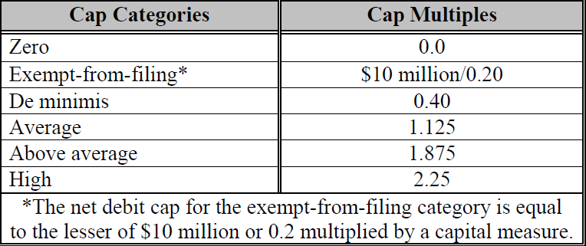
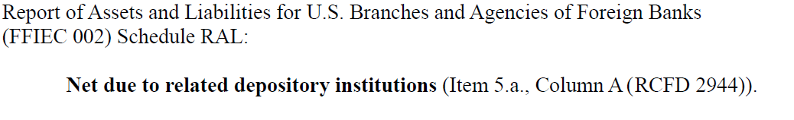
Fed Net Debit Caps Category
No filing requirements
Board resolution only
Board resolution & Self-assessment
BOCNY current category is Above Average, $43.3B daylight overdraft limit
If De minimis, BOCNY limit = 0.4* ~ $30 B (average) = $12 B
Note: for De minimis, the capital measure for FBO is the net due to amount in call report

Slide 19
Fed Account Net Flow Analysis
The analysis is based on the Fed account inflows and outflows from the past three years (754 Days). 5% Percentile of inflows: $3,008,947,159.20 1% Percentile of inflows: $ 1,767,876,541.21 5% Percentile of outflows: ($21,639,350,132.92) 1% Percentile of outflows: ($29,054,989,754.21) $(18,630,402,973.72) $ (27,287,113,213.00)
Total Inflow
Binomial Range | Frequency (# of Days) | Normal Distribution | Cumulative # of Days | Total # of Days | Probability
$1,500,000,000.00 | 3 | 0.00000000002 | 3 | 754 | 0%
$3,000,000,000.00 | 35 | 0.00000000003 | 38 |  | 5%
$5,000,000,000.00 | 89 | 0.00000000005 | 127 |  | 17%
$7,500,000,000.00 | 155 | 0.00000000006 | 282 |  | 37%
$10,000,000,000.00 | 144 | 0.00000000007 | 426 |  | 56%
$12,500,000,000.00 | 105 | 0.00000000006 | 531 |  | 70%
$15,000,000,000.00 | 81 | 0.00000000005 | 612 |  | 81%
$20,000,000,000.00 | 90 | 0.00000000002 | 702 |  | 93%
$25,000,000,000.00 | 39 | 0.00000000000 | 741 |  | 98%
$35,000,000,000.00 | 13 | 0.00000000000 | 754 |  | 100%
Total Outflows
Binomial Range | Frequency (# of Days) | Normal Distribution | Cumulative # of Days | Total # of Days | Probability
($30,000,000,000.00) | 7 | 0.00000000000 | 7 | 754 | 1%
($25,000,000,000.00) | 11 | 0.00000000000 | 18 |  | 2%
($20,000,000,000.00) | 34 | 0.00000000002 | 52 |  | 7%
($15,000,000,000.00) | 99 | 0.00000000005 | 151 |  | 20%
($10,000,000,000.00) | 175 | 0.00000000007 | 326 |  | 43%
($7,500,000,000.00) | 131 | 0.00000000006 | 457 |  | 61%
($5,000,000,000.00) | 160 | 0.00000000005 | 617 |  | 82%
($2,500,000,000.00) | 108 | 0.00000000003 | 725 |  | 96%
$0.00 | 29 | 0.00000000002 | 754 |  | 100%

Slide 20
Fed Account Balance Analysis
5% Percentile of Fed account Balance: $24,940,886,426.72
1% Percentile of Fed account Balance: $21,002,906,120.42
Fed account balance is sufficient to cover the net outflows at 5% percentile and would result in around $6 Billion funding gap if assuming a 1% percentile. Therefore, De Minimis ($12B) category is sufficient based on past three years’ performance.

Slide 21
Fed Account Seasonality Analysis
Based on past three years' performance, the volatilities usually happen at month ends. The greatest volatilities occur at month ends of 2014 October, 2015 January, March and September and 2016 September.
Worst Historical Dates
Dates | Outflow | Inflow | Fed Account Balance | Gap | In general, Fed account beginning balance is sufficient to cover the negative daily position, even at the worst historical dates over the past 3 years. There was only once when funding gap ($4.5B) arose.
09/30/2016 | ($44,626,689,831.53) | $14,218,148,335.92 | $25,894,288,784.45 | ($4,514,252,711.16)
09/28/2015 | ($43,938,656,336.87) | $31,106,122,714.39 | $43,435,069,290.51 | $30,602,535,668.03
10/28/2014 | ($34,838,868,987.20) | $29,484,928,432.43 | $69,811,492,320.73 | $64,457,551,765.96
01/04/2016 | ($34,193,047,397.60) | $14,842,744,041.40 | $26,429,277,641.42 | $7,078,974,285.22
01/28/2015 | ($33,363,101,556.04) | $32,175,624,883.34 | $46,172,439,021.56 | $44,984,962,348.86
03/27/2015 | ($31,562,974,594.77) | $34,224,010,574.18 | $61,639,434,591.36 | $64,300,470,570.77
09/08/2015 | ($31,454,155,529.94) | $17,964,021,268.84 | $65,970,883,231.09 | $52,480,748,969.99
09/14/2016 | ($29,470,134,494.87) | $24,457,404,749.25 | $36,697,547,984.23 | $31,684,818,238.61

Slide 22
Table of Content
GAP ASSESSMENT: REGULATORY REQUIREMENTS VS. BOCNY PRACTICE
INTRADAY LIQUIDITY MANAGEMENT PROPOSAL
MONITORING TOOLS
APPENDIX

Slide 23
Intraday Liquidity Risk Management Monitoring
v
Monitoring tools to consider:
Available intraday liquidity at the start of the business day
Daily maximum intraday liquidity usage
Total payments in the day
Intraday credit lines extended to customers as correspondent bank
Intraday throughput
Fed account monitoring
Monitoring & Reporting
Overdraft limit usage
Extended credit lines usage
Cash Position
CLD provides precaution limits of Fed account balance to TRD & OSD
Escalation

Slide 24
Stressed Scenario Analysis
Stressed
Scenario
Own financial stress: a bank suffers, or is perceived to be suffering from, a stress event
Counterparty stress: a major counterparty suffers an intraday stress event which prevents it from making payments
A customer bank’s stress: a customer bank of a correspondent bank suffers a stress event
Market-wide credit or liquidity stress
The Bank needs to build up capabilities to conduct stressed scenario analysis.
(Refer to CHIPs for market wide stress)

Slide 25
APPENDIX

Slide 26
Practical example of the monitoring indicators

Slide 27
Practical Example of Monitoring Tools
Direct participant
Details of the bank’s payment profile are as followings:
Payment A: 450
Payment B: 100 – to settle obligations in an ancillary system
Payment C: 200 – which has to be settled by 10 am
Payment D: 300 –on behalf of a counterparty using some of a 500 unit unsecured credit line that the bank extends to the counterparty
Payment E: 250
Payment F: 100
The bank has 300 units of central bank reserves and 500 units of eligible collateral.

Slide 28
Practical example of the monitoring tools
Daily maximum liquidity usage:
largest negative net cumulative positions: 550 units
largest positive net cumulative positions: 200 units
Available intraday liquidity at the start of the business day:
300 units of central bank reserves + 500 units of eligible collateral (routinely transferred to the central bank) = 800 units
Total payments:
Gross payments sent: 450+100+200+300+250+100 = 1,400 units
Gross payments received: 200+400+300+350+150 = 1,400 units
Time-specific obligations:
200 + value of ancillary payment (100) = 300 units
Value of payments made on behalf of correspondent banking customers: 300 units
Intraday credit line extended to customers:
Value of intraday credit lines extended: 500 units
Value of credit line used: 300 units

Slide 29
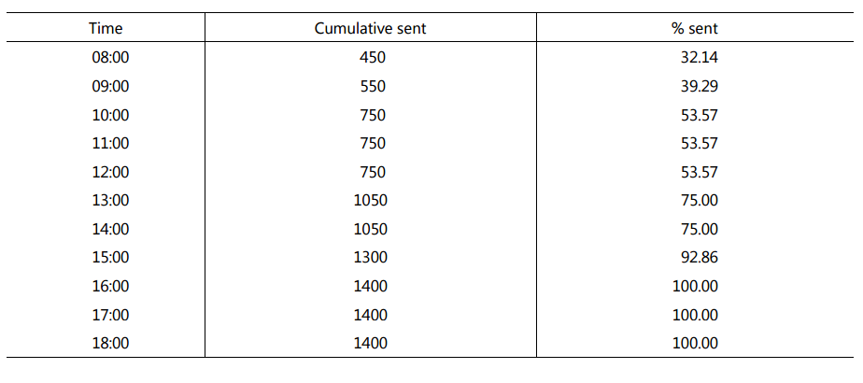
Practical example of the monitoring tools
Intraday throughput:

Slide 30
CHIPS Stress Test & Recovery and Wind-Down Plan

Slide 31
CHIPS Stress Test – Participant Outage Simulation
Simulation Stress Test Description
The CHIPS quarterly simulation for 2016 consists of baseline and four scenarios. This exercise is conducted to simulate the effect of a CHIPS bank’s operational and / or technical issues hampering the inbound and outbound payment messages.
Stricken Bank: In this simulation, certain scenarios include a full outage (no outbound or inbound payments to the stricken bank), while other scenarios feature a partial outage which impact processes that run the outbound and inbound queues. In this scenario the stricken bank is not able to send outbound payments however continues to receive incoming payments. In order to create adverse scenarios, we chose the stricken bank based on the maximum net debit and net credit positions during production baseline environment.
Active Banks: During a full outage active banks will not receive or send payments to the stricken bank. In the partial outage scenario, the active banks will continue to send outbound payments to the stricken bank, but will not receive inbound payments from the stricken bank. Such events are plausible if the active banks are not aware that the stricken bank is experiencing a technical issues. Payments destined to the stricken bank continue to settle until the stricken bank reaches a CHIPS maximum credit cap limit. Some payments may settle due to supplemental funding. Remaining payments will continue to accumulate in a ‘stored’ status until credit cap is raised at 3PM and ultimately lifted at CHIPS cutoff (5PM).
Scenarios Addressed the Following Stress Factors
– Reduced use of supplemental funds
– CHIPS payment volume and payment dollar value decrease
– Liquidity absorption followed by liquidity imbalance
– Trapped Liquidity
– Timing of the Outage
Simulation Output
CHIPS Network analysis and participant specific analysis
– Engine efficiency, payment traffic flow, funding impact

Slide 32
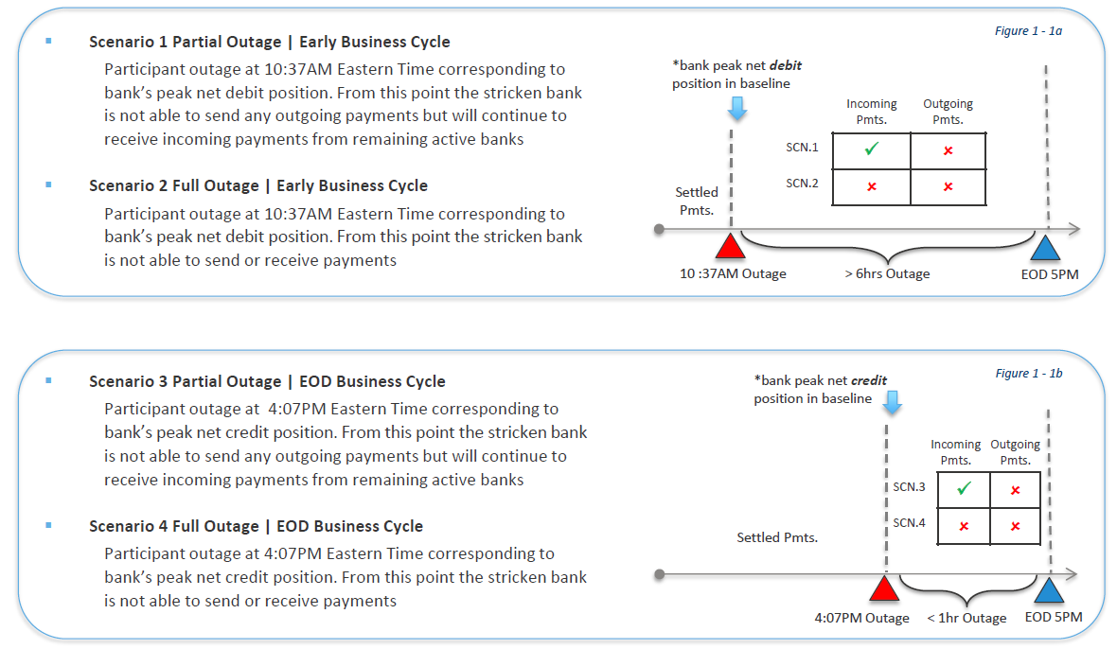
CHIPS Stress Test – Participant Outage Simulation
Overview of Scenarios

Slide 33
CHIPS Stress Test – Participant Outage Simulation
Stress Testing Metrics
PayCo has identified a set of performance metrics that both signal a change in the CHIPS Network environment and at a participant micro level during the simulation. These metrics are applied consistently to all CHIPS stress tests to capture trending and pattern behavior.
1.Coverage Ratio: 1 – (Net Dollar Amount Unresolved at 5PM / Total Dollar Value Released)
The coverage ratio measures the percentage of dollar value that CHIPS was able to clear without final funding or additional receives from other participants
2.Payments remaining at cutoff (dollar value)
3.Payments released before cutoff (dollar value)
4.End-of-Day (EOD) Total Funding: Initial Funding (IF) + Net Supplemental Funding (SF) + Final Funding (FF)
5.Liquidity Efficiency Ratio: Total Payments Released (dollar value) / Total funding (Initial + Supplemental + Final Funding)
The liquidity efficiency ratio determines the amount of transactions that CHIPS processed given the total funding provided by participants
6.Liquidity Efficiency Ratio Intraday (LERI): Tiered Approach
7.Payment Throughput: tiered dollar value grouping
8.Engine Performance Analysis: payment offset release mechanism (unilateral, bilateral, multilateral netting)
9.Final Funding Ratio: EOD Final Funding / Total Payments Released (dollar value)
The final funding ratio measures the required amount of funds at the end of the day relative to the total daily payment dollar value

Slide 34
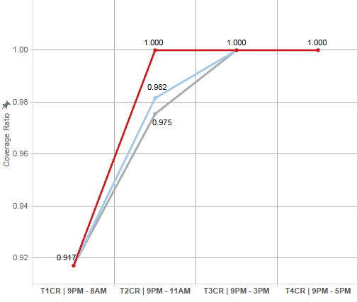

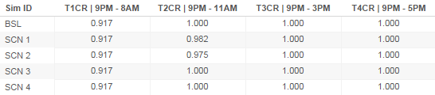
CHIPS Stress Test – Participant Outage Simulation
Bank of China Coverage Ratio Coverage Ratio = 1 – (net dollar value unresolved / total released payments dollar value)
The primary factors of coverage ratio during this simulation are Bank of China’s level of connectivity to the stricken bank and bilateral positions at the time of the outage
Severely Adverse Case | Scenario 2
– Figure 2 – 1a illustrates the deviation of SCN2 curve from BSL curve at the time of the outage. This spread tightens towards long range of the curve and eventually resembles baseline curve at the end of the day. The deviation from baseline can be attributed to increased unresolved payments at the time of the outage
Adverse Case | Scenario 1
– Bank of China reduced coverage ratio during scenario 1 is primarily driven by two key factors, (a) trapped liquidity – the stricken bank continues to absorb liquidity by receiving incoming payments from active banks; (b) absence of offsetting payment transactions due to the stricken bank’s inability to deliver payments to the remaining active participant, triggers increased in unreleased payments at cutoff
Scenarios 3 and 4 did not generate material adverse impact mainly due to low exposure of bilateral positions at 4PM. As a reference point, percent of CHIPS payments received and released after 4PM is roughly 2.00%

Slide 35
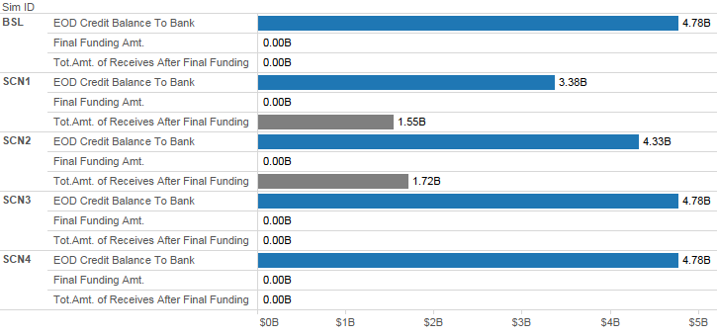
CHIPS Stress Test – Participant Outage Simulation
Bank of China End of Day Balance & Final Funding
–Scenario 1 Bank of China received $1.55B after cutoff, which would generally be expected to settle with Bank of China earlier in the day. This is due to the prolonged liquidity imbalance created by the stricken bank, accompanied by the lack of offsetting payment transactions . At a broader systemic level this scenario created conditions of negative debit bi-lateral position which required final funding at cutoff among active participants
–Scenario 2 Bank of China received $1.72B after cutoff
–Scenario 3 and 4 simulation output resembled Bank of China baseline production environment

Slide 36
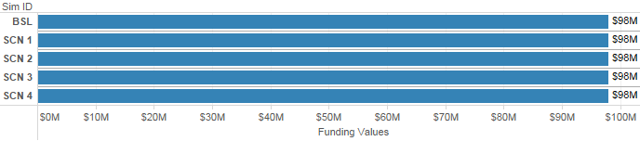
CHIPS Stress Test – Participant Analysis
Bank of China Participant Funding
Participant funding outcome follows a set of general principles;
–the impact of final funding on active participants will primarily depend on their level of relationship / connectivity to the stricken bank
–active bank’s level of exposure to the stricken bank at the time of the outage
–systemic importance of the stricken bank to the entire network
In this simulation, Bank of China was not required to submit final funding as all BOC payments settled prior to cutoff
Scenarios 1-4 resembled baseline production environment with $98 million dollar initial funding

Slide 37
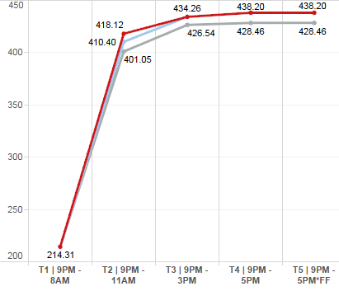
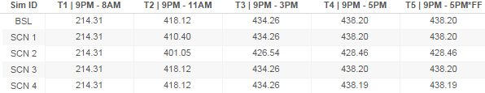
CHIPS Stress Test – Participant Analysis
Bank of China
Liquidity Efficiency Ratio Intra Day
Liquidity Efficiency Ratio = Total Payments Released (dollar value) / total funding (IF+SF+FF)
The intraday liquidity efficiency curve is derived by calculating total participant funding (initial funding, supplemental funding, final funding) relative to participant’s payments processed (dollar value)
The impact of participant’s liquidity efficiency is primarily based on active bank’s level of connectivity to the stricken bank
Severely Adverse Case |Scenario 2
–The decrease in liquidity efficiency is representative of missing payments from the stricken bank while maintaining unchanged funding
Adverse Case | Scenario 1
–The decline of SCN1 liquidity efficiency in Tier 2 is indicative of the absence of expected offsetting payments from the stricken bank. The reduced number of payments account for the Liquidity Efficiency

Slide 38
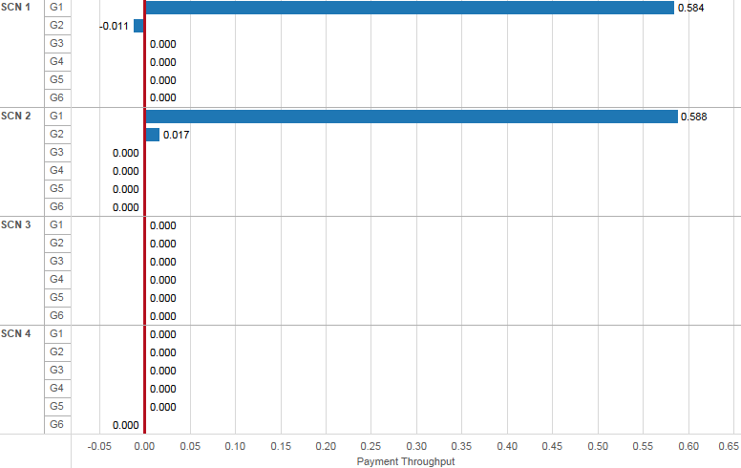
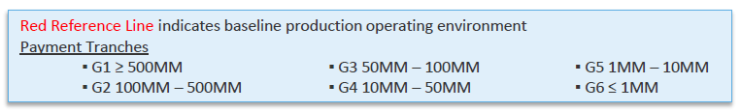
CHIPS Stress Test – Participant Analysis
Bank of China
Payment Throughput
The early outage scenarios displayed similarities in payment throughput impact. In both scenarios 1 and 2 payment delay originated from high value payments
– This can be attributed to the missing G1 and G2 payments which would have normally been expected to offset remaining payments in the system
Scenarios 3 and 4 did not generate material adverse impact due to low exposure of bilateral positions at 4PM

Slide 39
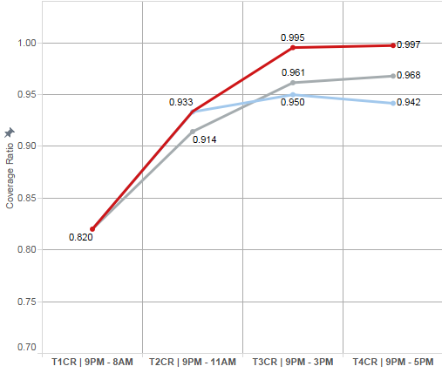
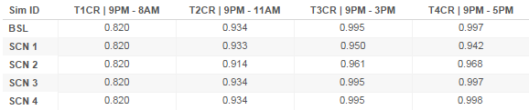
CHIPS Stress Test – Network Analysis
Coverage Ratio
Coverage Ratio=1-(net dollar value unresolved/total released payments dollar value)
Figure 3 – 1a illustrates concave downward coverage curves indicating that the ratio of unreleased to released payments was improving, however at a slower rate than baseline. This is due to liquidity absorption and reduced intraday funding incurred during the early business cycle. As a result, the widest spread between baseline and simulation scenarios did not exceed 0.055, which tells us that the deviation from baseline was relatively minor at a macro network level
Adverse Scenario | Scenario 2
–The coverage curve spread between BSL and SCN2 widens during mid-day and remains upward slopping towards end of day indicating marginal impact. The deviation from baseline can be mostly attributed to increased unreleased payments at cutoff
Severely Adverse Scenario | Scenario 1
–Due to increasing trapped liquidity and absence of offsetting payment transactions, variation between baseline and scenario 1 coverage ratios widen during T3 (mid-day) and continue to push downwards during the long end of the curve T4 (end of day)

Slide 40

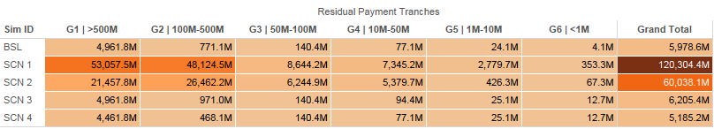
CHIPS Stress Test – Network Analysis
Residual Payments at Cutoff
Severity of impact among payments remaining at cutoff was mostly driven by the following key factors:
( a ) systemic importance of a stricken bank
( b ) timing of stricken bank’s outage
( c ) bi-lateral exposure of active banks to the stricken bank
( d ) imbalance of liquidity, whether the bank remains as an absorbing node
Adverse Case | Scenario 2
–Notable rise in unresolved payments, with a skewed distribution of residual payments towards high value payments
Severely Adverse Case | Scenario 1
–Similar to the adverse case, increase in unreleased payments with larger concentration in high value payments G1 and G2
The impact of unreleased payment during scenarios 3 and 4 remained muted due to minimal exposure of bi-lateral positions between stricken participant and remaining active participants

Slide 41
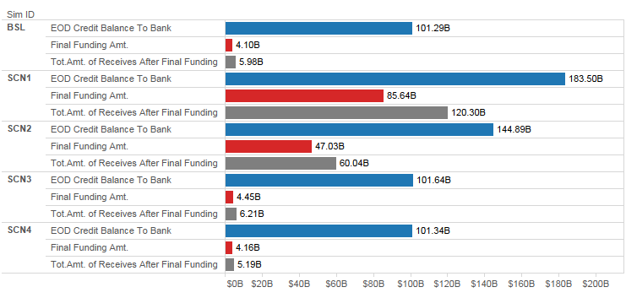
CHIPS Stress Test – Network Analysis
Residual Payments & Final Funding
Adverse Case | Scenario 2
–Due to the absence of liquidity during scenario 2 number of payments were not released until end of day final funding. Scenario 2 required moderate final funding
Severely Adverse Case | Scenario 1
–Similar to the adverse case, the steady liquidity absorption created by the stricken bank, accompanied by the lack of offsetting payment transactions created conditions of high negative debit bi-lateral position at cutoff among active participants. The increase in unreleased positions at cut off required higher final funding during scenario 1

Slide 42
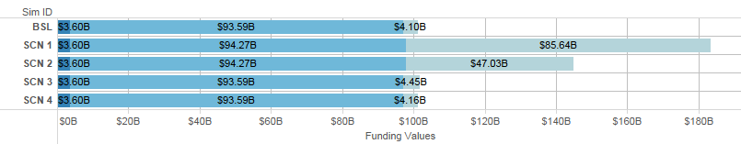
CHIPS Stress Test – Network Analysis
Total Funding
Adverse Case | Scenario 2
–The final funding increase reflects adverse effects of contraction in intraday liquidity flow and payment throughput. The end of day final funding is mostly driven by the absence of expected incoming payments
Severely Adverse Case | Scenario 1
–Similar to adverse case, sharp increase in final funding during scenario 1 can be attributed to disruption of liquidity flow. During this scenario the adverse effects are compounded with additional factors of ( a ) trapped liquidity – the stricken bank continues to absorb liquidity by receiving incoming payments from active banks; ( b ) absence of offsetting payment transactions – the stricken bank’s inability to deliver payments to the remaining active participant, consequently triggering final funding requirements

Slide 43
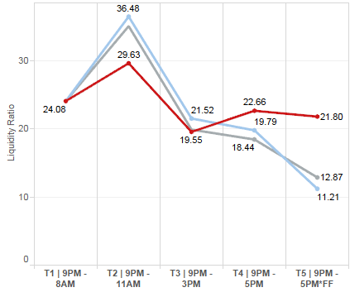
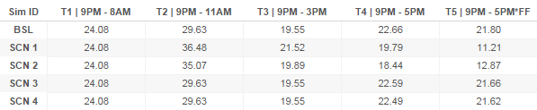
CHIPS Stress Test – Network Analysis
Liquidity Efficiency Ratio Intra Day
Liquidity Efficiency Ratio = Total Payments Released (dollar value) / total funding (IF+SF+FF)
Adverse Case | Scenario 2
–Figure 3 – 5a illustrates the effects of missing intraday liquidity along with increased final funding at the end of the day. Note that the spread between baseline and scenario 2 continued to widen towards EOD. The downward trend accompanied by a steeper decline during Tier 4 and Tier 5 is attributed to higher final funding at end of day cycle
Severely Adverse Case | Scenario 1
–The liquidity imbalance in scenario 1 pushed the liquidity efficiency curve downward during the mid and long range of the curve. The SCN1 LERI curve fell below baseline in Tier 3 (mid-day) and continue to decline towards end of day cutoff period
–The additional final funding submitted during scenario 1 Tier 5 end of day cycle adds to final recession of liquidity efficiency

Slide 44
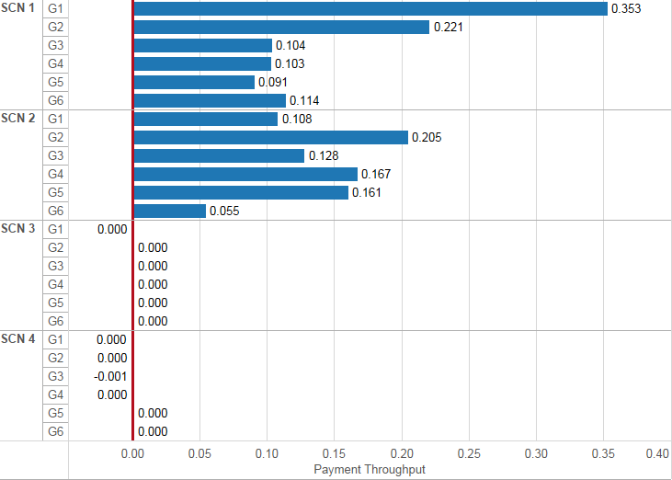
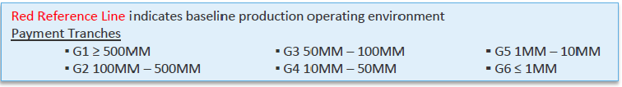
CHIPS Stress Test – Network Analysis
Payment Throughput
Figure 3 – 6 illustrates the increase in payment throughput during scenarios 1 and 2 across all payment tranches
Adverse Scenario Case | Scenario 2
–Scenario 2 the broad increase in payment throughput should be interpreted as a slowdown in payment flow mostly due to high levels of liquidity being removed early in the day
Severely Adverse Case | Scenario 1
–Scenario 1 exhibits increased payment throughput, which is further pronounced in high value payments (HVP’s) G1 and G2

Slide 45
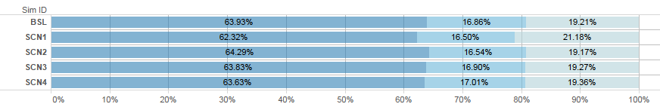
CHIPS Stress Test – Network Analysis
Payment Offset
Engine offset (payment batching process) generated marginal impact, as the CHIPS engine was able to release payments with relatively minor deviations from production baseline performance
At a network level all four scenarios generated minimal variance from production baseline environment. The resilience of the payments netting process is noted by the moderate impact in distribution of batching among unilateral, bilateral and multilateral batches
Figure 3 – 7 displays the marginal shift from unilateral payments to bi and multi-lateral batching
–production baseline Uni-lateral 63.93% | Bi-lateral 16.86% | Multi-lateral 19.21%
–Adverse Case: scenario 2 Uni-lateral 64.29% | Bi-lateral 16.54% | Multi-lateral 19.17%
–Severely Adverse Case: scenario 1 Uni-lateral 62.32% | Bi-lateral 16.50% | Multi-lateral 21.18%

Slide 46
CHIPS Orderly Wind-Down Simulation
Recovery and Wind-Down Plan
Section 234.3(a)(3)(iii) of Federal Reserve Regulation HH requires, among other things, identification of criteria that could trigger implementation of an OWD, wind-down strategies, tools, and procedures, and a notification and communication process.
Categories of Stressed Scenarios (CPSS-IOSCO)
Losses caused by general business and operational risk
–CHIPS Revenue Decline
–CHIPS Costs Escalate
–CHIPS Revenue Declines and PayCo Costs Increase
–Extraordinary/Unanticipated Costs

Slide 47
CHIPS Orderly Wind-Down Simulation
Overview of the Scenario
Scenario 1 (Big Bang)
–All CHIPS participants are removed from the network at the beginning of the business day 9:00PM Eastern Time
Scenario 2 (tiered approach 20 / 80)
–Phase 1: removal of lower tier participants (20% payment volume) at the beginning of the business day - 9:00PM Eastern Time
–Phase 2: commencing five business days after phase 1 - removal of remaining top-tier participants (80% payment volume)
Scenario 3 (tiered approach 80 / 20)
–Phase 1: removal of top tier participants (80% payment volume) at the beginning of the business day 9:00PM Eastern Time
–Phase 2: commencing five business days after phase 1 - removal of remaining lower tier participants (20% payment volume)
Scenario 4 (multi-phased tiered approach)
–Phase 1: lower tier participants with low level of connectivity to top-tier banks are removed from the network at the beginning of the business day 9:00PM Eastern Time
–Phase 2: commencing five business days after phase 1 - removal lower tier participants with high level of connectivity to top-tier banks (15% payment volume)
–Phase 3: commencing five business days after phase 2 - removal top-tier participants (80% payment volume)
In order to provide a comprehensive view of participant behavior, scenarios 2, 3, and 4 were executed with three variations of supplemental funding:
•Supplemental Funding unchanged
•Supplemental Funding increased 50%
•Supplemental Funding decreased 50%
–Assumption is made that payments will be re-directed to Fedwire, or via other correspondent banking channels
Time Horizon
–U.S. Holiday peak volume days 1/20/2015 – 2/3/2015 (January business cycle)
–Normal high volume days 4/20/2015 – 5/5/2015 (April business cycle)

Slide 48
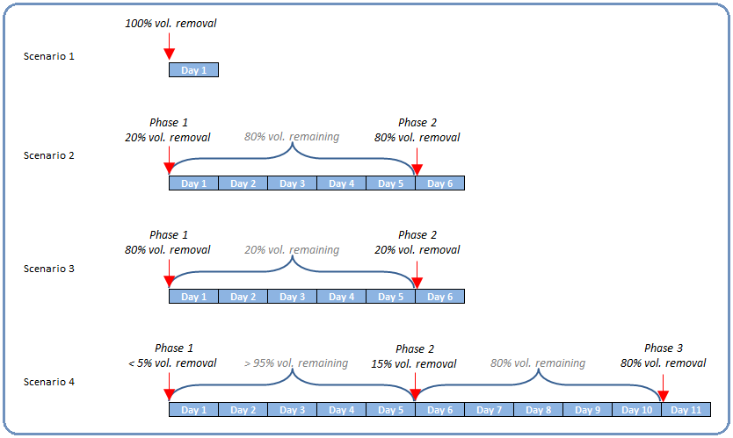
CHIPS Orderly Wind-Down Simulation
Overview of the Scenario (continued)
Figure 2 - 1 details the wind-down strategy of scenarios
The sequence of scenarios applies to both Holiday Peak Volume cycle (January) and Normal High Volume cycle (April)
Scenario 1 has limited simulation data output due to removal of all participants prior to start of Day 1

